Slide 1
Steganography Lab

Slide 2
Steganography Lab
Show simple examples of steganography
Materials needed
Kali Linux Machine
Software Tools used
zip command (Linux command)
steghide (Linux program)

Slide 3
Objectives Covered
Security+ Objectives (SY0-501)
Objective 2.2 - Given a scenario, use appropriate software tools to assess the security posture of an organization
Steganography Tools
Objective 6.1 - Compare and contrast basic concepts of cryptography
Steganography

Slide 4

What is Steganography?
A type of obfuscation where the actual message does not attract attention
A message is embedded in an image
TCP packets have message embedded inside them
Watermarks that are invisible to the eye on the paper
This image has the message “You may be compromised, meet your handler at headquarters” embedded in it.

Slide 5
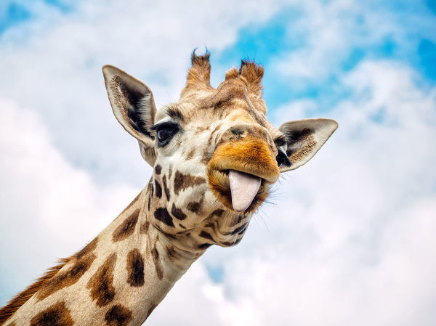
The Steganography Lab
Setup Environment
Embedded text (zip command)
Embedded text (steghide app)

Slide 6
Setup Environment
Log into your range
Open the Kali Linux Environment
You should be on your Kali Linux Desktop

Slide 7
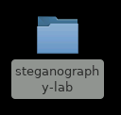
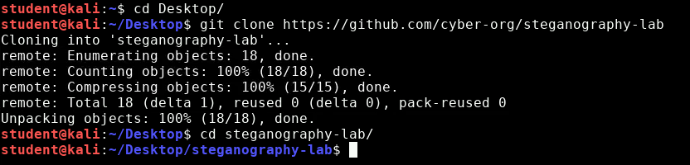
Get Steganography Lab Files
Open the terminal and navigate to the Desktop
cd Desktop
Download Collision Lab files
git clone https://github.com/cyber-org/steganography-lab
You should see the Steganography Lab folder
Navigate into this directory
cd steganography-lab

Slide 8
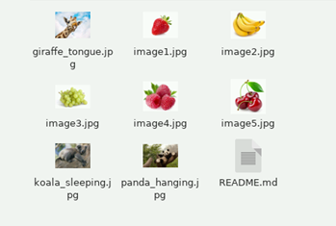
Embedded Text (zip Command)
Take a look at the images inside of this folder
Double click on the steganography lab folder
Open the images and see if you see any hidden messages
3 of the images have hidden messages

Slide 9
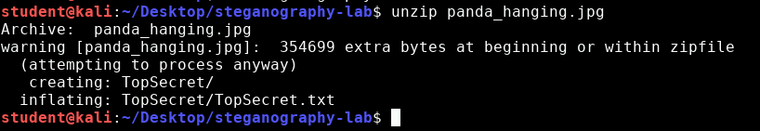
Embedded Text (zip Command)
Let’s discover the text hidden inside of the panda_hanging.jpg image
Go back to the terminal
When inside the folder, unzip the image
unzip panda_hanging.jpg
Notice that a TopSecret.txt file was extracted from this image

Slide 10
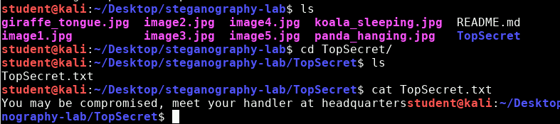
Embedded Text (zip Command)
What does the TopSecret.txt file say?
List all the files in the folder
ls
Notice there is a TopSecret folder
Navigate into this folder and list all the files
cd TopSecret
ls
Read the TopSecret.txt file
cat TopSecret.txt
Notice the hidden message that was embedded in the image

Slide 11

Embedded Text (zip Command)
Your turn to hide a message in an image just like this one. Create the message here:
Navigate back to steganography-lab folder
cd ..
Create and edit the text document
nano SekretMessage.txt
Enter your secret message to be hidden
Press CTRL+X, then Y, and ENTER to save

Slide 12
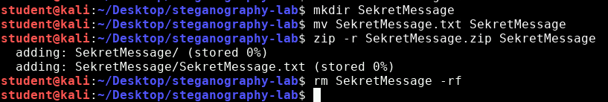
Embedded Text (zip Command)
Now, put the message in a zipped folder:
Create a directory:
mkdir SekretMessage
Move the message into the directory
mv SekretMessage.txt SekretMessage
Zip the directory
zip -r SekretMessage.zip SekretMessage
Remove the old directory
rm SekretMessage -rf

Slide 13

Embedded Text (zip Command)
Concatenate the zipped file with image1:
Combine the files
cat image1.jpg SekretMessage.zip > berry.jpg
Delete the old message
rm SekretMessage.zip
Navigate to the berry.jpg file, notice it’s just an image of a strawberry…
…or is it?

Slide 14
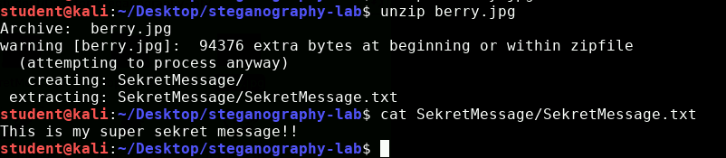
Embedded Text (zip Command)
Without unzipping the image, try to find the embedded message inside the berry.jpg image:
Now, unzip the file and find the hidden message
unzip berry.jpg
Display the message
cat SekretMessage/SekretMessage.txt

Slide 15
Embedded Text (zip Command)
Your turn: Hide your own message
Create a text file (hidden message!)
Put the text file into a folder
Zip the folder (Recursively!)
Concatenate the zipped folder and image2.jpg to hide the message
Delete the old files (except new image with hidden message)
Then have someone else discover the hidden message!

Slide 16

Embedded Text (steghide app)
Install steghide:
sudo apt-get update
sudo apt-get install steghide
Enter “y” when/if prompted

Slide 17
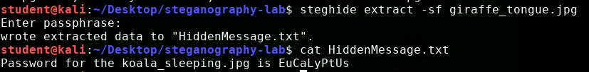
Embedded Text (steghide app)
Once steghide is installed, discover the hidden message inside of the giraffe image:
steghide extract -sf giraffe_tongue.jpg
When prompted for a passphrase:
Use “verytall” (without quotations)
Display the hidden message
cat HiddenMessage.txt
Notice that this gives the passphrase for the koala image. Find the hidden message embedded in the koala image

Slide 18
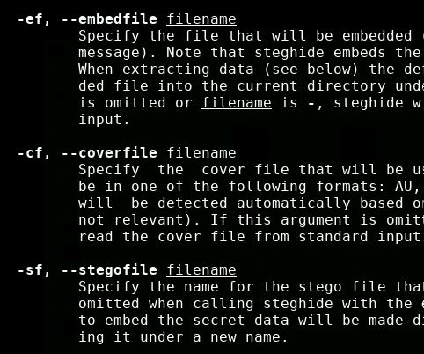
Embedded Text (steghide app)
Let’s read the manual for steghide:
man steghide
Locate the following flags/options:
-sf
-ef
-cf
What are the purpose of these flags/options?

Slide 19
Embedded Text (steghide app)
Create and edit the message
nano MessageToHide.txt
Enter your secret message to be hidden
Press CTRL+X, then Y, and ENTER to save

Slide 20
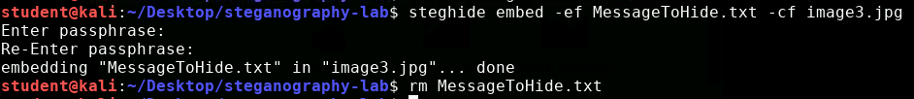
Embedded Text (steghide app)
Embed the message inside of image3.jpg
steghide embed -ef MessageToHide.txt -cf image3.jpg
Enter a password when prompted
Re-enter to confirm the password
Remove the old message
rm MessageToHide.txt

Slide 21
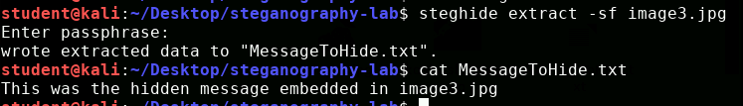
Embedded Text (steghide app)
Try to find the embedded text without steghide
Use steghide to find the message
steghide extract -sf giraffe_tongue.jpg
Enter password when prompted
Display the message
cat MessageToHide.txt

Slide 22
Embedded Text (steghide app)
Your turn: Hide your own message
Create a text file (hidden message!)
Hide the text file inside image4.jpg
Remember the password!
Delete the old message
Have someone else try to discover the hidden message!

